Slide 1
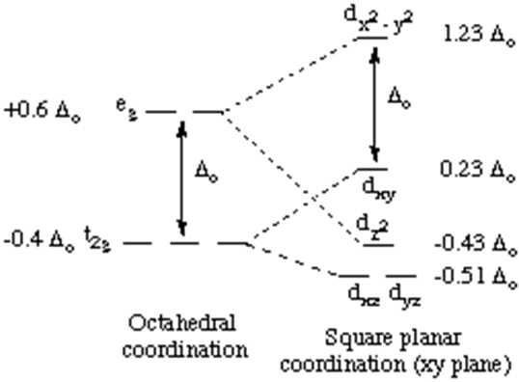
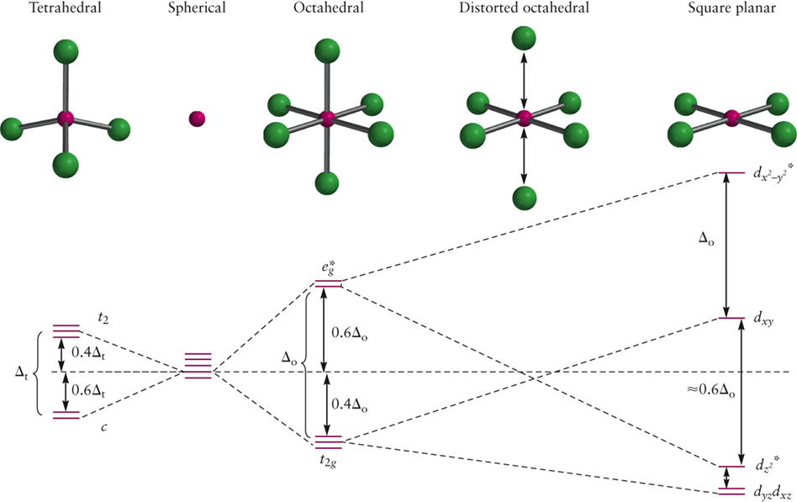
Did We Forget Square Planar Complexes?
Imagine that we have an octahedral complex from which we are removing the axial ligands. As ligands move away along the z-axis, d-orbitals with a z-component will fall in energy.
The d_{z2} orbital falls the most, as its electrons are concentrated in lobes along the z-axis.
The d_{xz} and d_{yz} orbitals also drop in energy, but not as much.
Conversely, the d_{x2-y2} and the d_{xy} orbitals increase in energy. The splitting diagram for square planar complexes is more complex than for octahedral and tetrahedral complexes, and is shown below with the relative energies of each orbital.

Slide 2
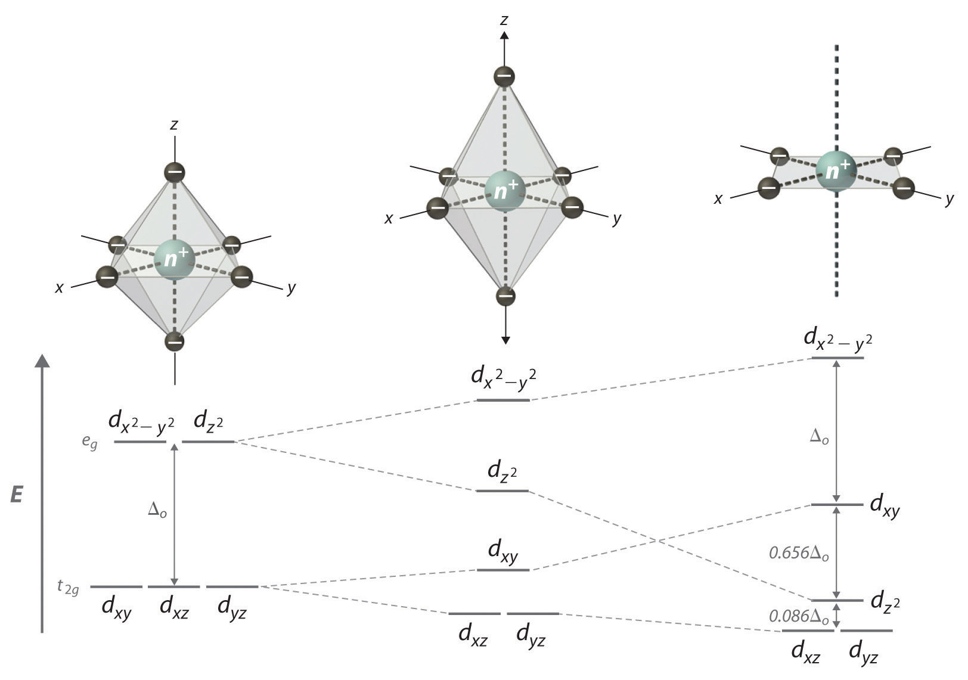
Tetragonal Distortion
Intermediate stages will lead to a “distorted” octahedral complex.

Slide 3
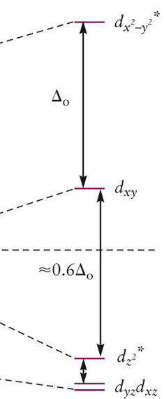
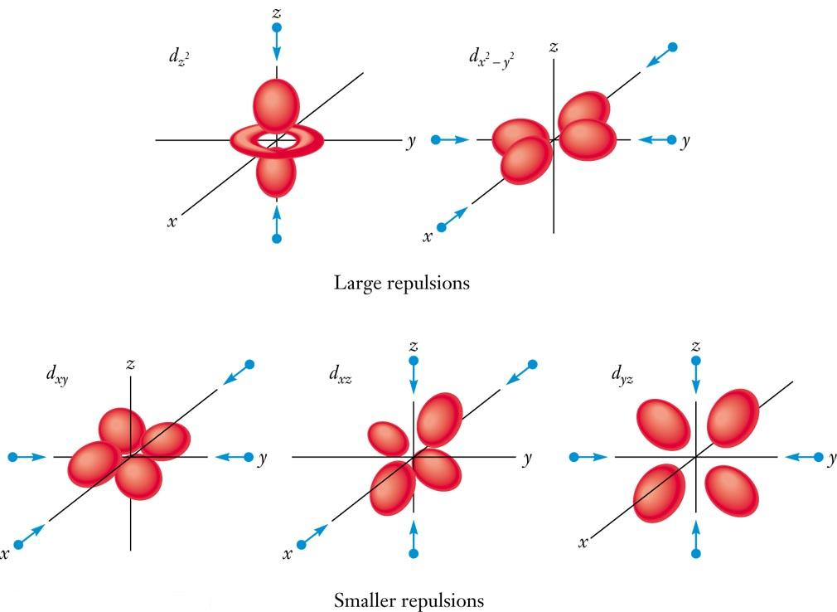
Square Planar Crystal Field

Slide 4

Square Planar Complexes
Why would a "happy" octahedral complex want to lose two of its ligands to make a square planar complex?
Square planar coordination is rare except for d⁸ metal ions. Occasionally, d⁹ complexes with large Δ_{O} also occur. 3d⁸ complexes with strong field ligands and 4d⁸, 5d⁸ complexes with any ligands can be expected to be square planar.
Examples of such d⁸ complexes are [Ni(CN)₄]²⁻, the anti-cancer drug cisplatin (cis-Pt(NH₃)₂Cl₂), [Pd(H₂O)₄]²⁺, and [AuCl₄]⁻.
At the d⁸ electron count, the lowest four orbitals are filled and the highest orbital (the d_{x}2_{-y}2) is empty, resulting in a large CFSE. These complexes are diamagnetic and tend to be quite stable.
The crystal field stabilization energy for a diamagnetic square planar d⁸ metal complex is readily calculated by the usual method:
The pairing energy correction is included because a free d⁸ ion has 2 unpaired electrons, but a square planar d⁸ complex has no unpaired electrons

Slide 5
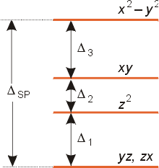
Square Planar Complexes: General Trends
As a result of these distortions, there is a net lowering of energy (an increase in the ligand field stabilization energy) for complexes in which the metal has a d⁷, d⁸, or d⁹ configurations, and thus electrons would occupy the upper e_{g} set if an octahedral complex.
In general, the size of the splitting in a square planar complex, Δ_{SP} is 1.3 times greater than Δ_{o} for complexes with the same metal and ligands. As a result, the distortion results in square planar complexes with lower energies than the comparable octahedral complex.
This distortion to square planar complexes is especially prevalent for d⁸ configurations and elements in the 4th and 5th periods such as: Rh (I), Ir (I), Pt(II), Pd(III), and Au (III). Nickel (II) four-coordinate complexes are usually tetrahedral unless there is a very strong ligand fields such as in [Ni(CN)₄]²⁻, which is square planar.

Slide 6
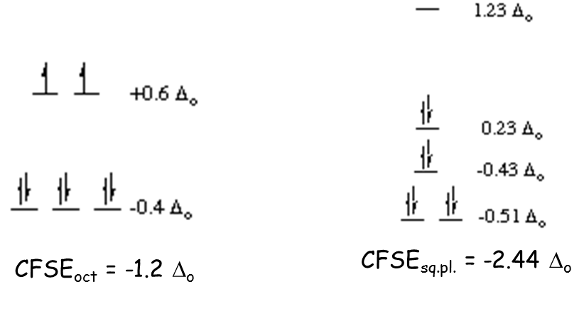
Nickel(II) vs. platinum(II): why is Pt²⁺ found only in
square planar coordination but Ni²⁺ is found in
several geometries?
Nickel forms the octahedral hexaammine complex, [Ni(NH₃)₆]²⁺, but platinum forms the square planar tetraammine complex [Pt(NH₃)₄]²⁺. Both metal ions have 8 d-electrons.
We can calculate a preference energy for octahedral over square planar coordination, just as we did for octahedral over tetrahedral. We will neglect the pairing energy for this calculation.

Slide 7
Nickel(II) vs. platinum(II)
Notice that in this case, the crystal field stabilization (in terms of Δ_{o}) is much greater for square planar coordination than for octahedral coordination! In fact, the preference energy (compared to octahedral coordination) for square planar coordination of a d⁸ metal ion is -1.24 Δ_{o}.
However, let's use the following values and determine the absolute values for the square planar preference in kJ/mol.
Complex | Δ_{o} (kJ/mol)
[Ni(NH₃)_{x}]²⁺ | 132
[Pt(NH₃)_{x}]²⁺ | 359
Preference for square planar coordination by [Ni(NH3)x]²⁺ = -1.24 (132 kJ/mol) = -164 kJ/mol
Preference for square planar coordination by [Pt(NH3)x]²⁺ = -1.24 (359 kJ/mol) = -445 kJ/mol

Slide 8
Nickel(II) vs. platinum(II)
Thus square planar [Pt(NH₃)₄]²⁺ is stabilized by nearly 300 kJ/mol more than the corresponding nickel complex. This greater energy difference is enough to make up for the loss in bond energy suffered as an octahedral platinum(II) complex is transformed to a square planar complex, but is not usually enough to favor square planar complexes for nickel.
So why does nickel form square planar complexes at all?
Actually, there are many fewer square planar complexes than there are octahedral ones. the ones that are square planar tend to be found with stronger-field ligands, i.e. those that are capable of giving high values for the octahedral splitting energy Δ_{o}.

Slide 9
Magnetism in Macroscopic Setting
N
S

Slide 10
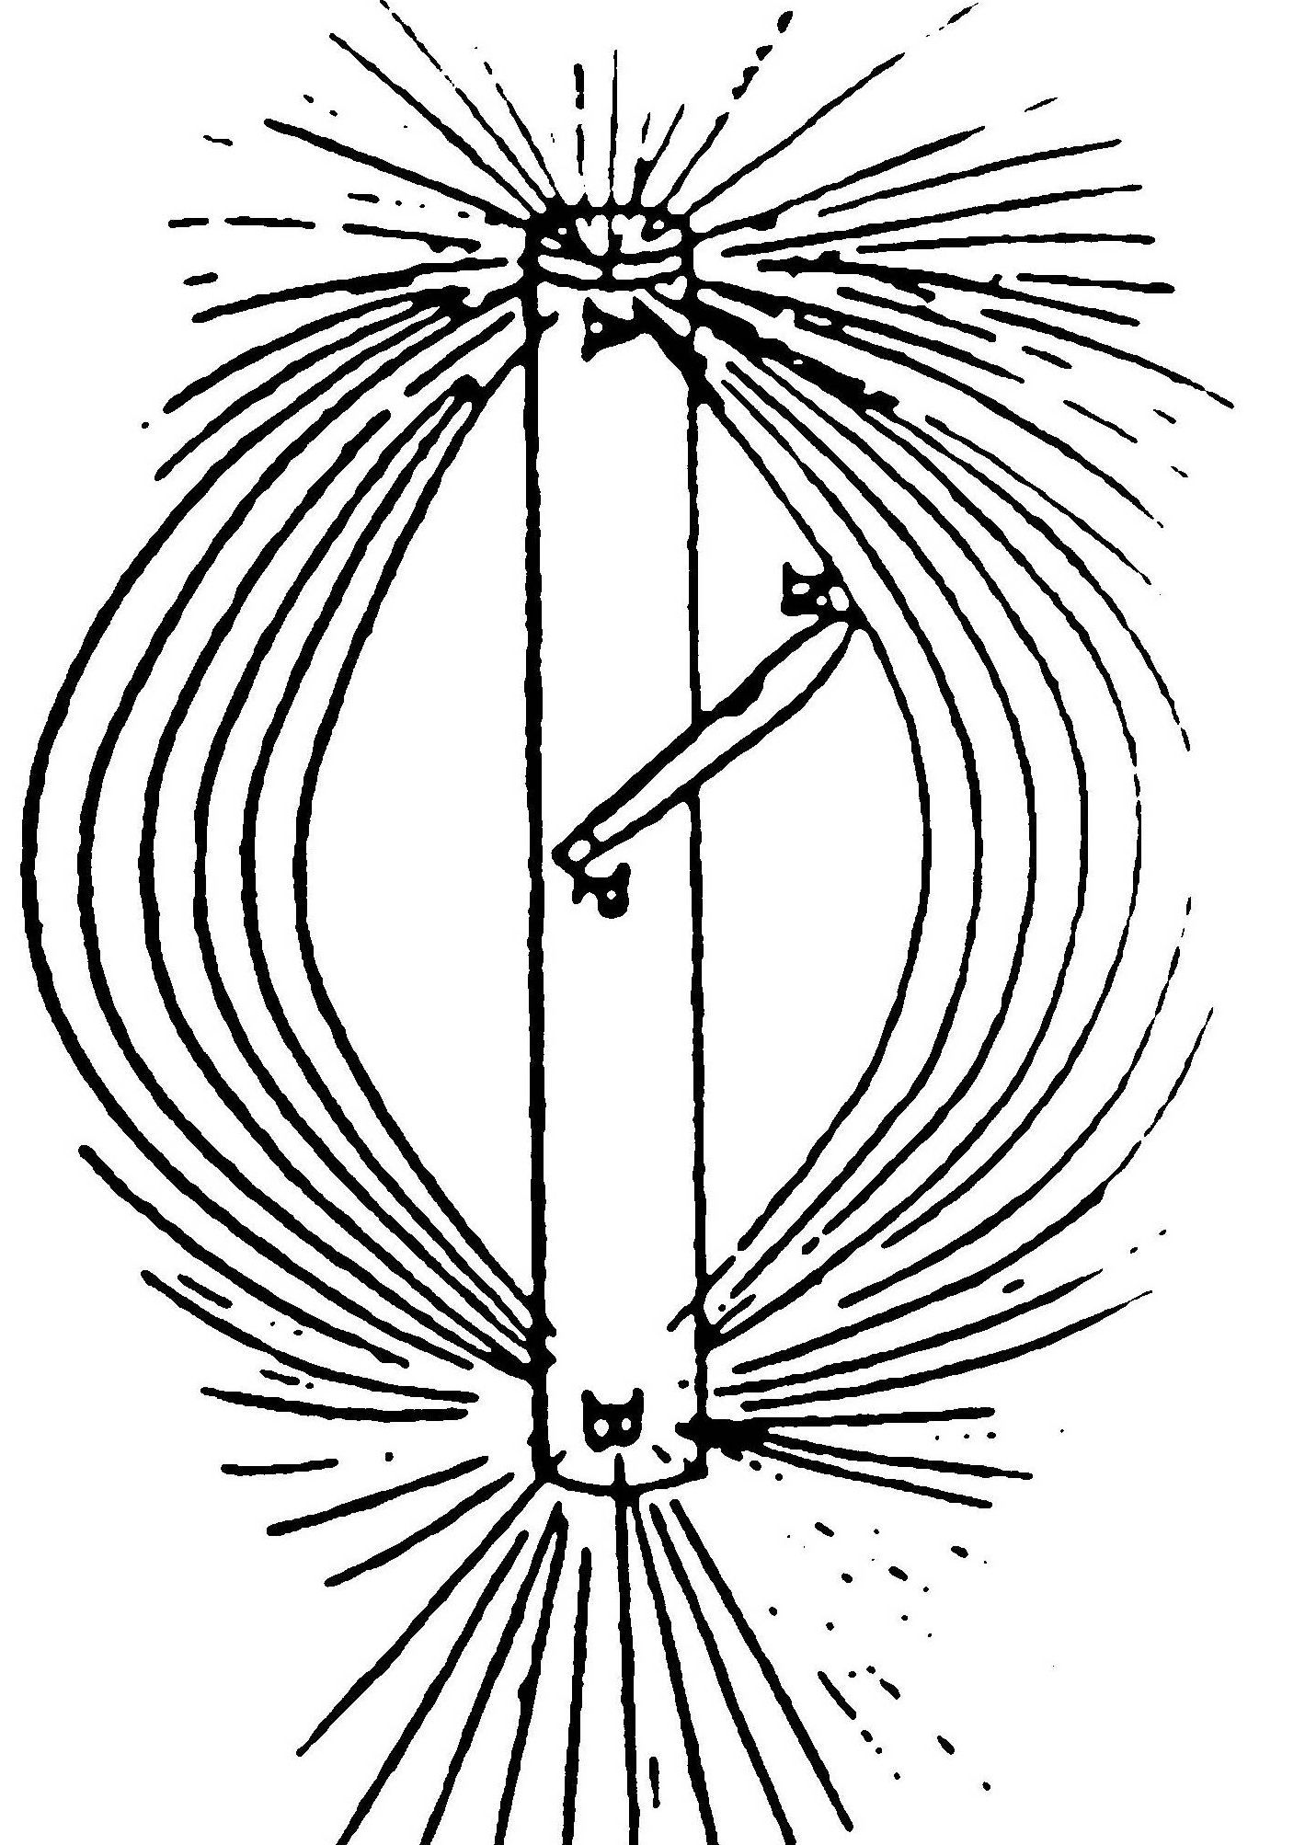
Magnetism in Macroscopic Setting
A pioneering experiment
by M. Faraday
« Farady lines of forces »
about magnetic flux
N
S

Slide 11
Magnetism in Macroscopic Setting
N
N
S
S
attraction
N
N
S
S

Slide 12
Magnetism in Macroscopic Setting
S
S
N
N
repulsion
N
N
S
S

Slide 13
Bulk Property as Cumulative Effect of Atomic
Magnetic Moments
N
many
sets of
domains
many
sets of
≡
≡
≡
≡
S
atomic
magnetic
moments

Slide 14
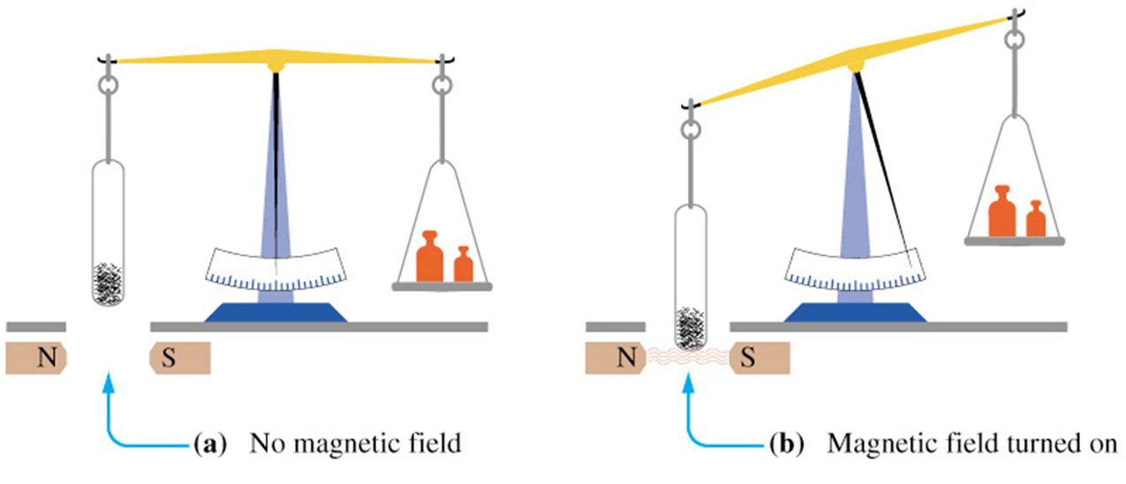
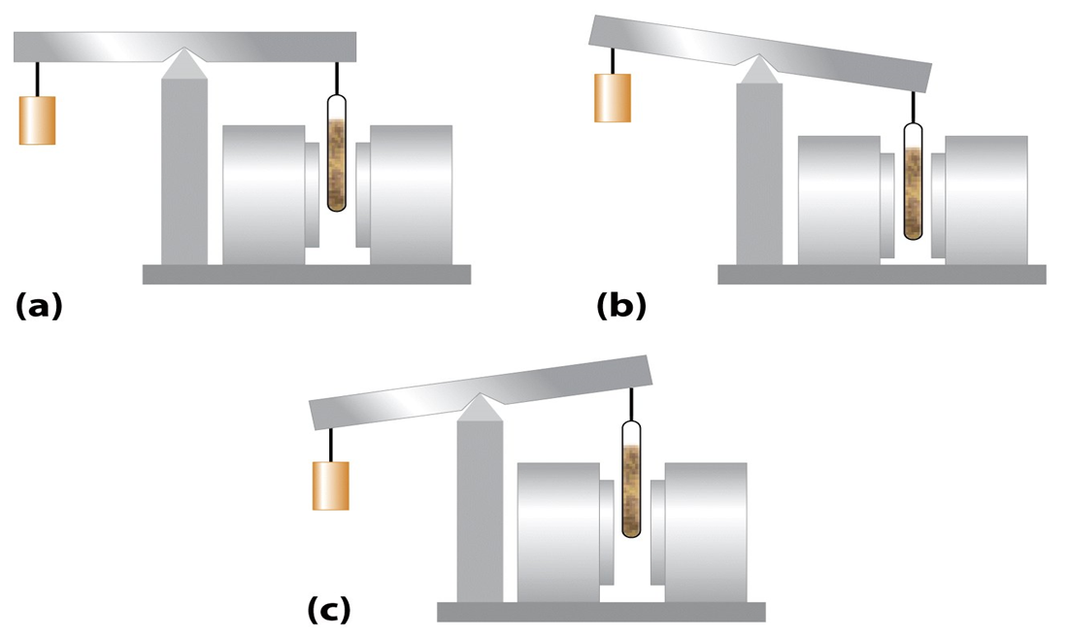
Magnetic Properties of Coordination Complexes
Some substances are attracted to magnetic field.
Some substances are repelled too.
Magnetic field “on”
Substance is paramagnetic
Magnetic field “off”
Magnetic field “on”
Substance is diamagnetic

Slide 15
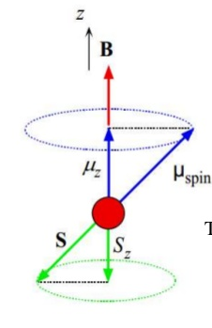
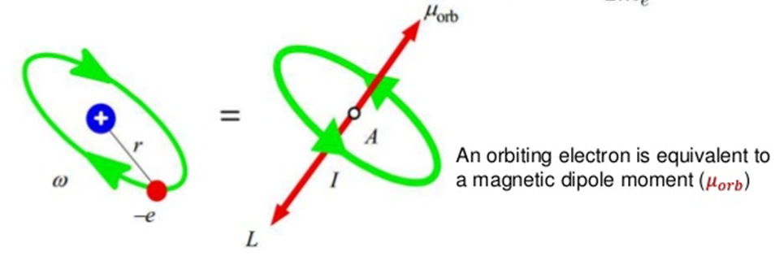
What Causes Paramagnetism?
Diamagnetic Compounds: Those, which tend to move out of a magnetic field. Example: N₂
Paramagnetic Compounds: Those, which tend to move into a magnetic field.
Example: O₂
The extent of paramagnetism is measured in terms of the magnetic moment, μ. The larger the magnitude of μ, greater the paramagnetism of the compound.
Magnetic moment has contributions from spin (S) and orbital angular momentum (L). A non-spherical environment may lead to quenching of the contribution from orbital angular momentum.

Slide 16
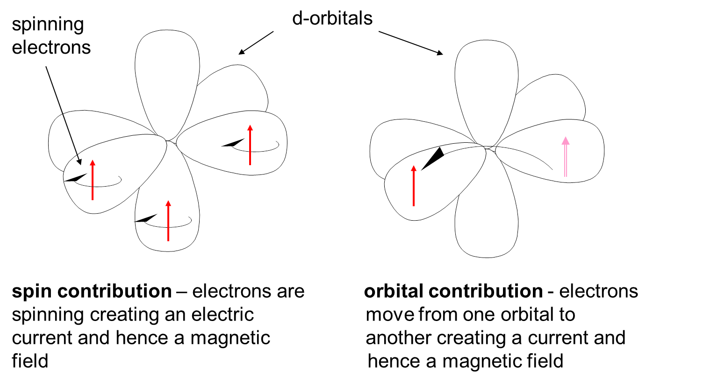
What Causes Paramagnetism?

Slide 17
Magnetic Properties of Coordination Complexes
Effective magnetic moment (μ_{eff})= [L(L+1) + 4S(S+1)]^{1/2}
For a given value of the orbital quantum number l, the magnetic quantum number m can have any values from –l to +l including 0 (zero) and L = Σm
For d-orbital electrons, l = 2, so, m= 2, 1, 0, -1, -2
If there is only one electron in the d-orbitals, L= 2
Experimental μ values effectively used to differentiate high-spin or low-spin states of complexes.
For 1st row transition metal ions, effect of L on μ is small and μ_{eff} correlate fairly well with those derived from the spin-only formula.
μ_{eff} = μ_{s.o.} = 2{S(S+1)}^{1/2} μ_{B} (μ_{B} is the Bohr magneton)
In terms of number of unpaired electrons “n”
μ_{eff} = μ_{s.o.} = {n(n+2)}^{1/2} μ_{B}

Slide 18
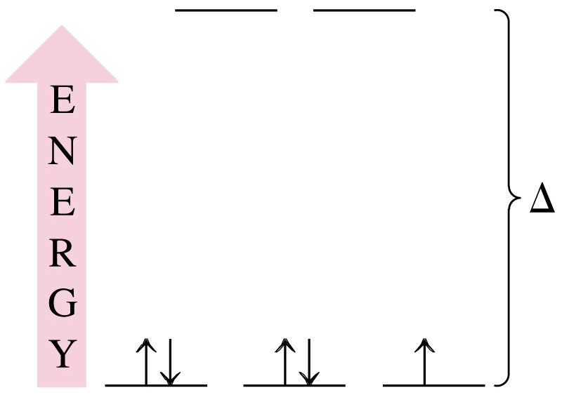
Magnetic Properties of Coordination Complexes
Using the Spectrochemical Series to predict magnetic properties.
How many unpaired electrons would you expect to find in the octahedral complex [Fe(CN)₆]³⁻?
Fe [Ar]3d⁶4s²
Fe³⁺ [Ar]3d⁵

Slide 19
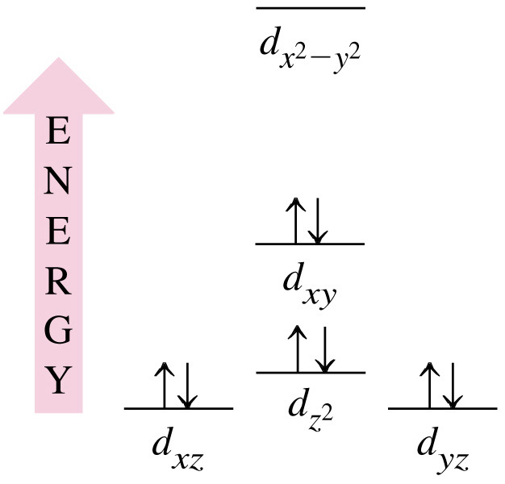
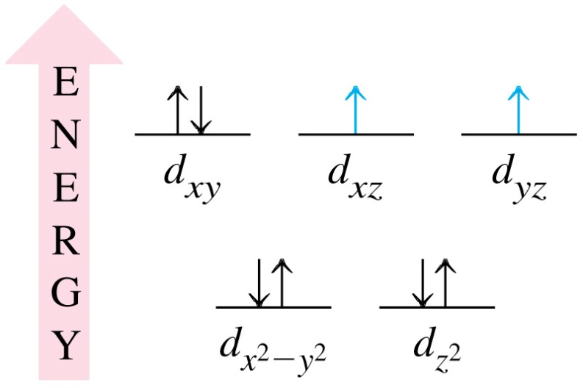
Magnetic Properties of Coordination Complexes
Using the Crystal Field theory to Predict the Structure of a Complex from Its Magnetic Properties.
The complex ion [Ni(CN₄)]²⁻ is diamagnetic. Use ideas from the crystal field theory to speculate on its probable structure.
Coordination is 4 so octahedral complex is not possible.
Complex must be tetrahedral or square planar.
Draw the energy level diagrams and fill the orbitals with e⁻. Consider the magnetic properties.
Solution:
Tetrahedral:
Square planar:

Slide 20
Some Calculations and Observations
The spin-only formula applies reasonably well to metal ions from the first row of transition metals: (units = μ_{B,}, Bohr-magnetons)
μ = {n(n+2)}^{1/2} μ_{B} where n = no. of unpaired electrons
Metal ion d^{n} configuration μ_{eff}(spin only) μ_{eff} (observed)
Ca²⁺, Sc³⁺ d⁰ 0 0
Ti³⁺ d¹ 1.73 1.7-1.8
V³⁺ d² 2.83 2.8-3.1
V²⁺, Cr³⁺ d³ 3.87 3.7-3.9
Cr²⁺, Mn³⁺ d⁴ 4.90 4.8-4.9
Mn²⁺, Fe³⁺ d⁵ 5.92 5.7-6.0
Fe²⁺, Co³⁺ d⁶ 4.90 5.0-5.6
Co²⁺ d⁷ 3.87 4.3-5.2
Ni²⁺ d⁸ 2.83 2.9-3.9
Cu²⁺ d⁹ 1.73 1.9-2.1
Zn²⁺, Ga³⁺ d¹⁰ 0 0

Slide 21
When does Orbital Angular Momentum Contribute?
Essential conditions:
1. The orbitals should be degenerate (t_{2g} /t₂ or e_{g}/e)
2. The orbitals should have similar shape and size, transformable to each other
by rotation.
3. Orbitals must not be symmetrically occupied (half-filled/full-filled).
For an octahedral complex, orbital contributions are possible only when the t_{2g} orbitals are differentially occupied and for a tetrahedral complex the t₂ orbitals have to be differentially occupied.

Slide 22
When does Orbital Angular Momentum Contribute?

Slide 23
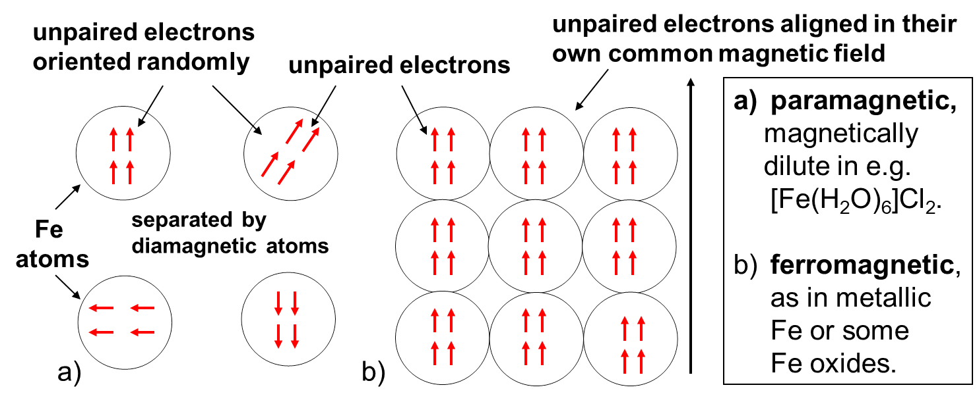
Ferromagnetism
In a normal paramagnetic material, the atoms containing the unpaired electrons are
magnetically dilute, and so the unpaired electrons in one atom are not aligned with
those in other atoms.
However, in ferromagnetic materials, such as metallic iron, or iron oxides such as
magnetite (Fe₃O₄), where the paramagnetic iron atoms are very close together, they can
create an internal magnetic field strong enough that all the centers remain aligned:

Slide 24
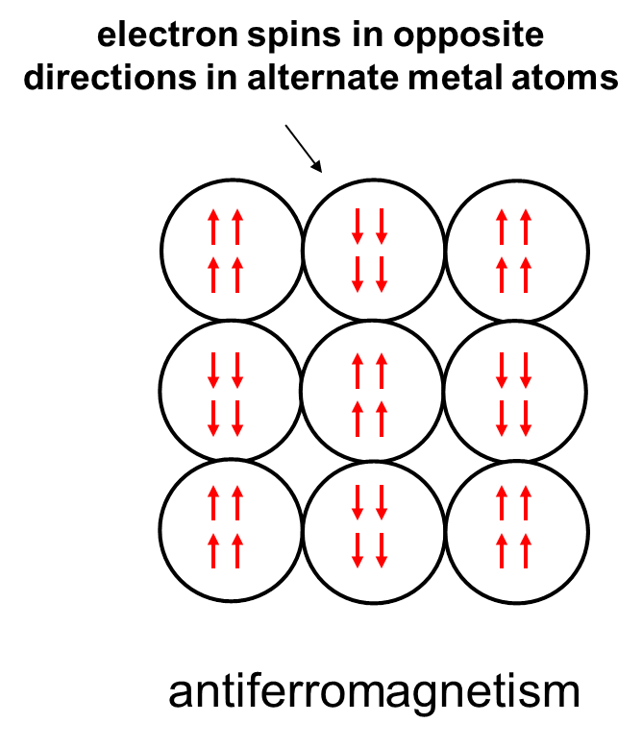
Antiferromagnetism
Here the spins on the unpaired electrons become aligned in opposite directions so that the μ_{eff} approaches zero, in contrast to ferromagnetism, where μ_{eff} becomes very large.
An example of anti-ferromagnetism is found in MnO.

Slide 25
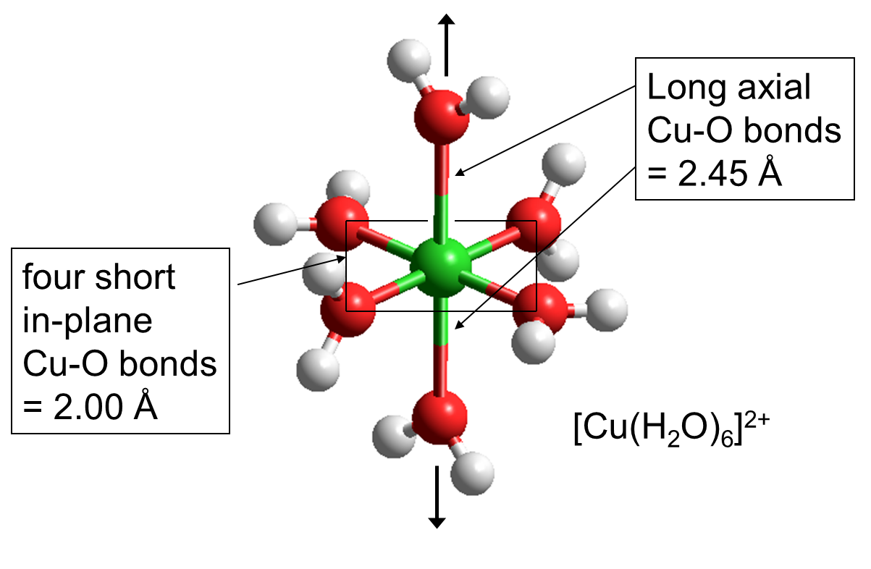
Back to Structures and Geometry…….
So far we have considered “perfect” geometries, i.e., we expect a complex of the type ML₆ to have all bonds equivalent. But….

Slide 26
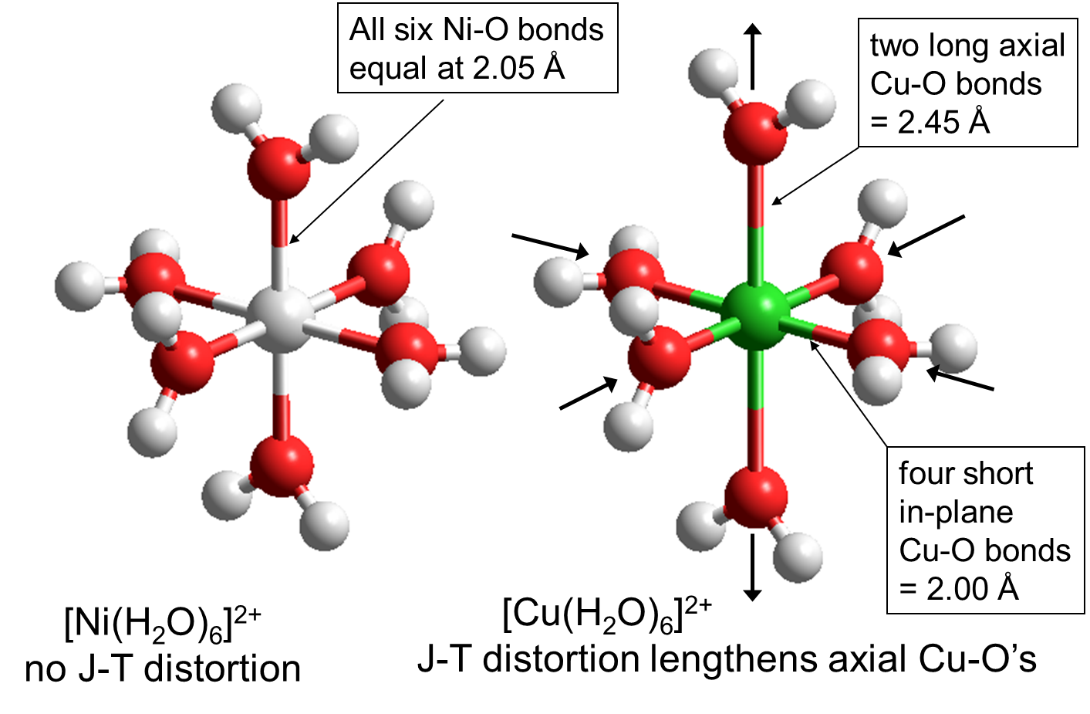
Distorted Octahedral Complex
Not all complexes exhibit such distortion.
This phenomena is referred to as Jahn-Teller distortion

Slide 27
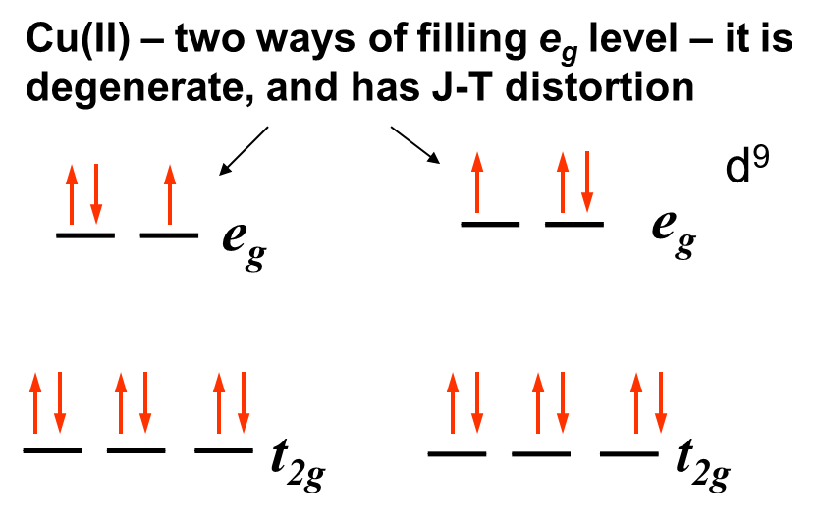
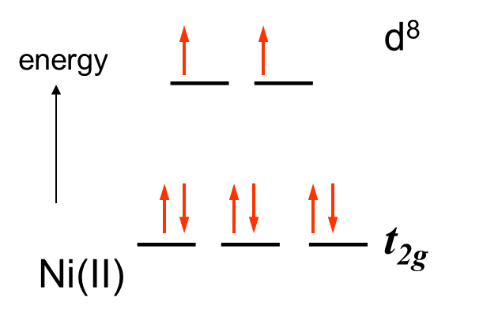
The Jahn-Teller Theorem
The Jahn-Teller (J-T) theorem states that in molecules/ ions that have a degenerate ground-state, the molecule/ion will distort to remove the degeneracy.
This is a fancy way of saying that when orbitals in the same level are occupied by different numbers of electrons, this will lead to distortion of the molecule.
For us, what is important is that if the two orbitals of the e_{g} level have different numbers of electrons, this will lead to J-T distortion.
High-spin Ni(II) – only one way of filling
the e_{g} level – not degenerate,
no J-T distortion

Slide 28
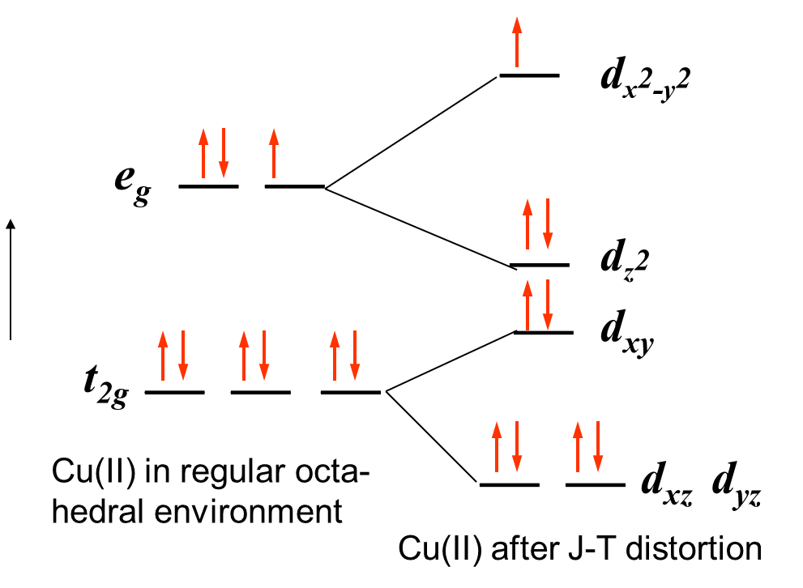

Further Splitting of the t_{2g} and e_{g} Levels
The CF view of the splitting of the d-orbitals is that those aligned with the two more distant donor atoms along the z-coordinate experience less repulsion and so drop in energy (d_{xz}, d_{yz}, and d_{z2}), while those closer to the in-plane donor atoms (d_{xy}, d_{x2-y2}) rise in energy.
Lowering of energy (although small) is the motivation behind distortion.

Slide 29
J-T Distortion for d¹ System
in molecules/ ions that have a degenerate ground-state, the molecule/ion will distort to remove the degeneracy.

Slide 30
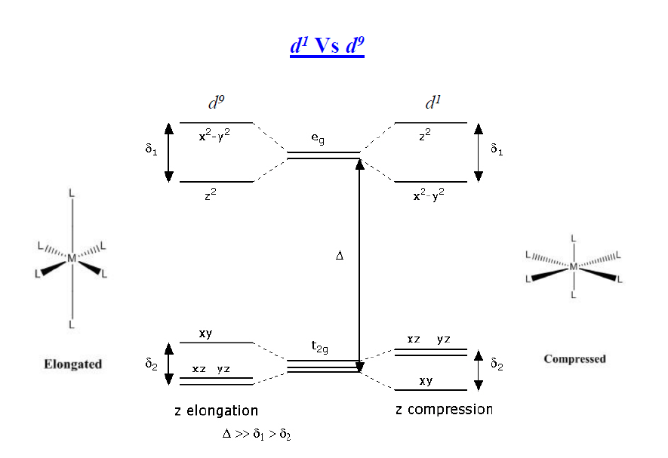
Comparison of d¹ and d⁹ Systems
Z-out
Z-in
Distortions are more pronounced if degeneracy occurs in an e_{g} orbital.

Slide 31
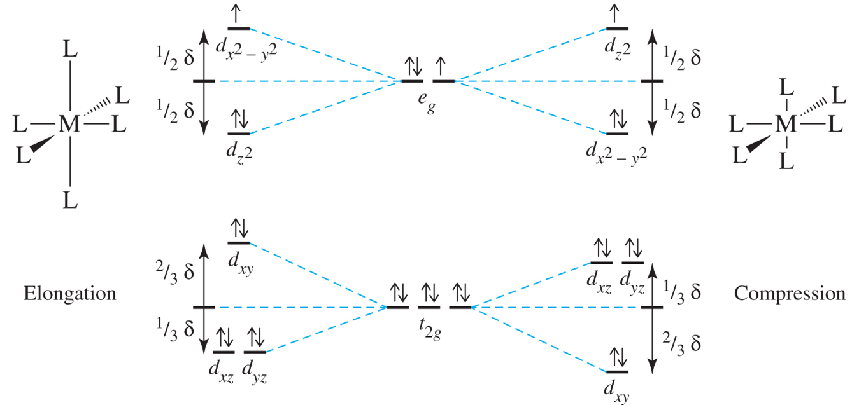
General Picture
Z-out
Z-in
Distortions are more pronounced if degeneracy occurs in an e_{g} orbital.

Slide 32
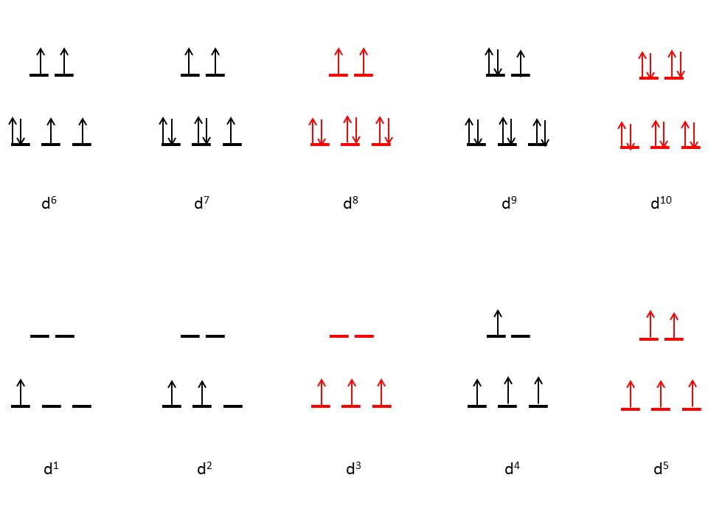
J-T Distortion Possibilities for High-Spin
Octahedral Complexes

Slide 33
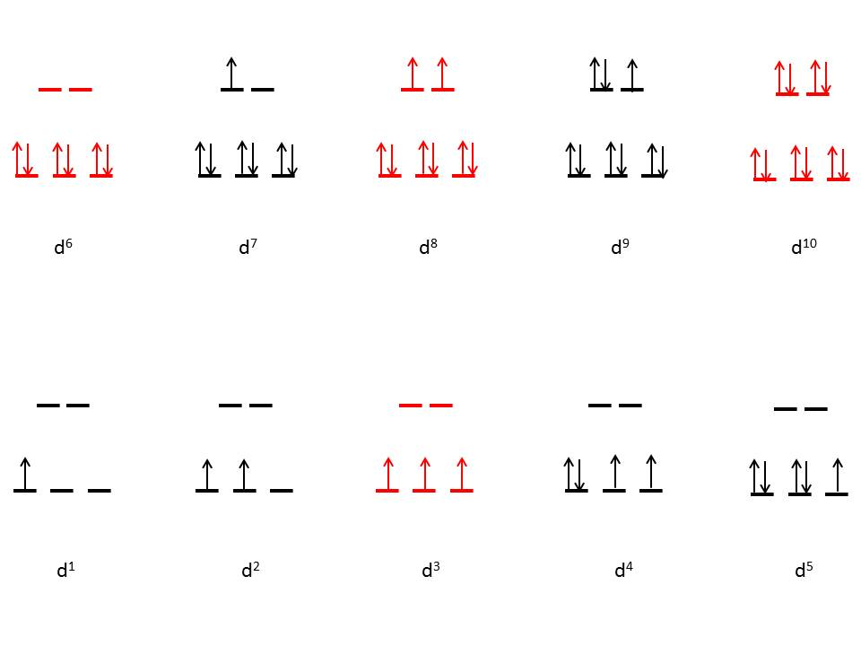
J-T Distortion Possibilities for Low-Spin
Octahedral Complexes

Slide 34
Will a d² system Exhibit Compression or Elongation?

